Slide 1
TCS Online Simulation: A basic overview
Aidan Brooks
LVC meeting, March 14th 2016
Pasadena

Slide 2
History
“Set CO2X laser to 0.23W”
Wait for response of IFO
Maybe preheat the test masses a little
Worry about long time constant lenses
Some thought about strength of lenses
A little thought (during commissioning) about varying mode size shape

Slide 3
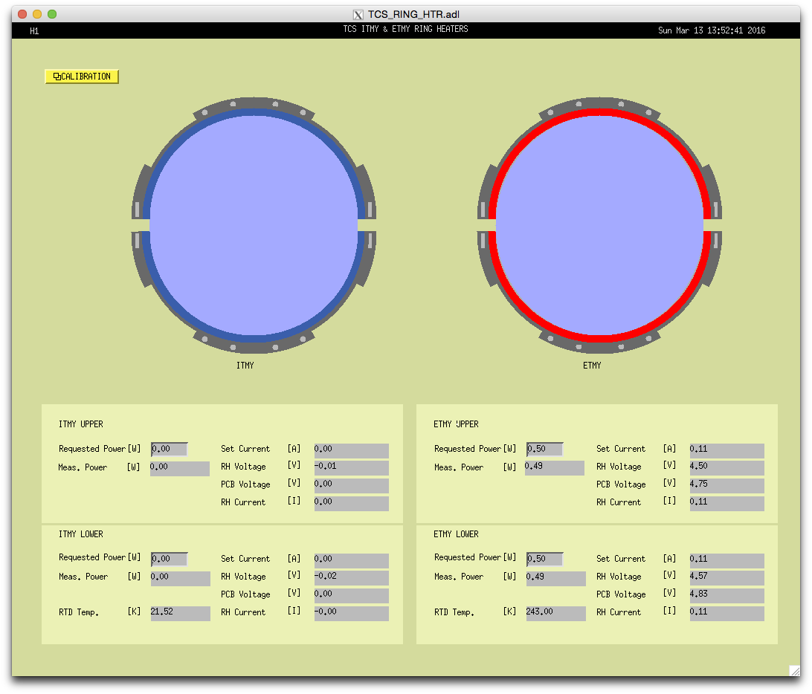
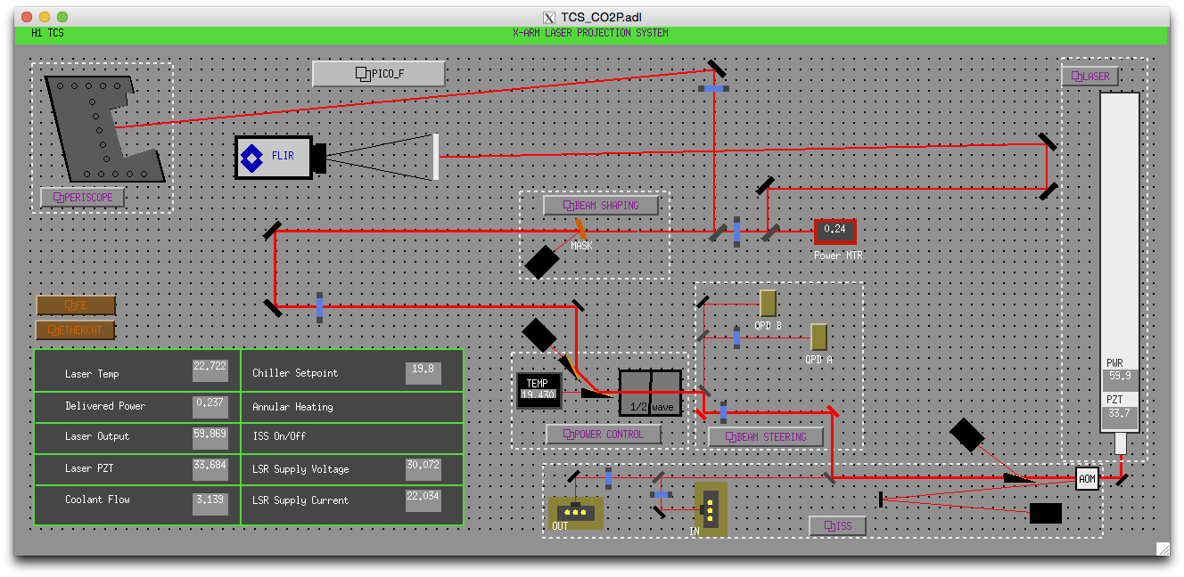
Lots of resources available
RH Power
CO2 power
HWS measurements
(response of different thermal lenses)
Power in the arms
Nominal ROC
Nominal distances between optics
Math
Etc

Slide 4
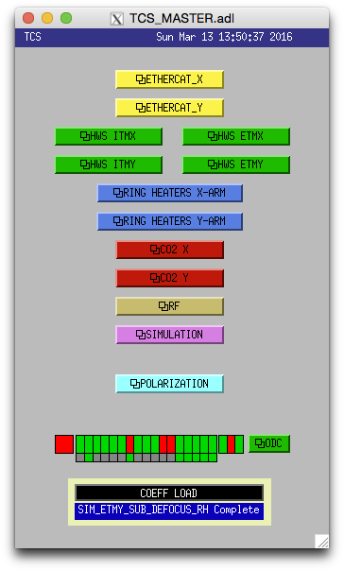
Online IFO Simulation & motivation (mode-matching focus)
Tool: modes of the different cavities
Transient effects
Properties depending on Lenses/ROC
Can potentially incorporated
More intuition of thermal state
Lens strength, actual ROC, etc
Monitor absorption
Higher power > need more TCS
AWC: SR3 heater going in
Diagnostic tool but possibly derive better control signals for feedback

Slide 5
H1:TCS-SIM Two Parts
Thermal state:
Lenses
ROC
Transient response/steady-state
Lenses/ROC at any time
based on known inputs
H1:TCS-SIM_ITMX
IFO state
Values based on optical properties
More useful for commissioning
Common/diff lenses in Michelson
Gouy Phase in SRC/PRC
HOM spacing in cavities
Arm cavity mode size
Torsional spring constant
Mode-overlap between ARMS and RCs
H1:TCS-SIM_IFO

Slide 6
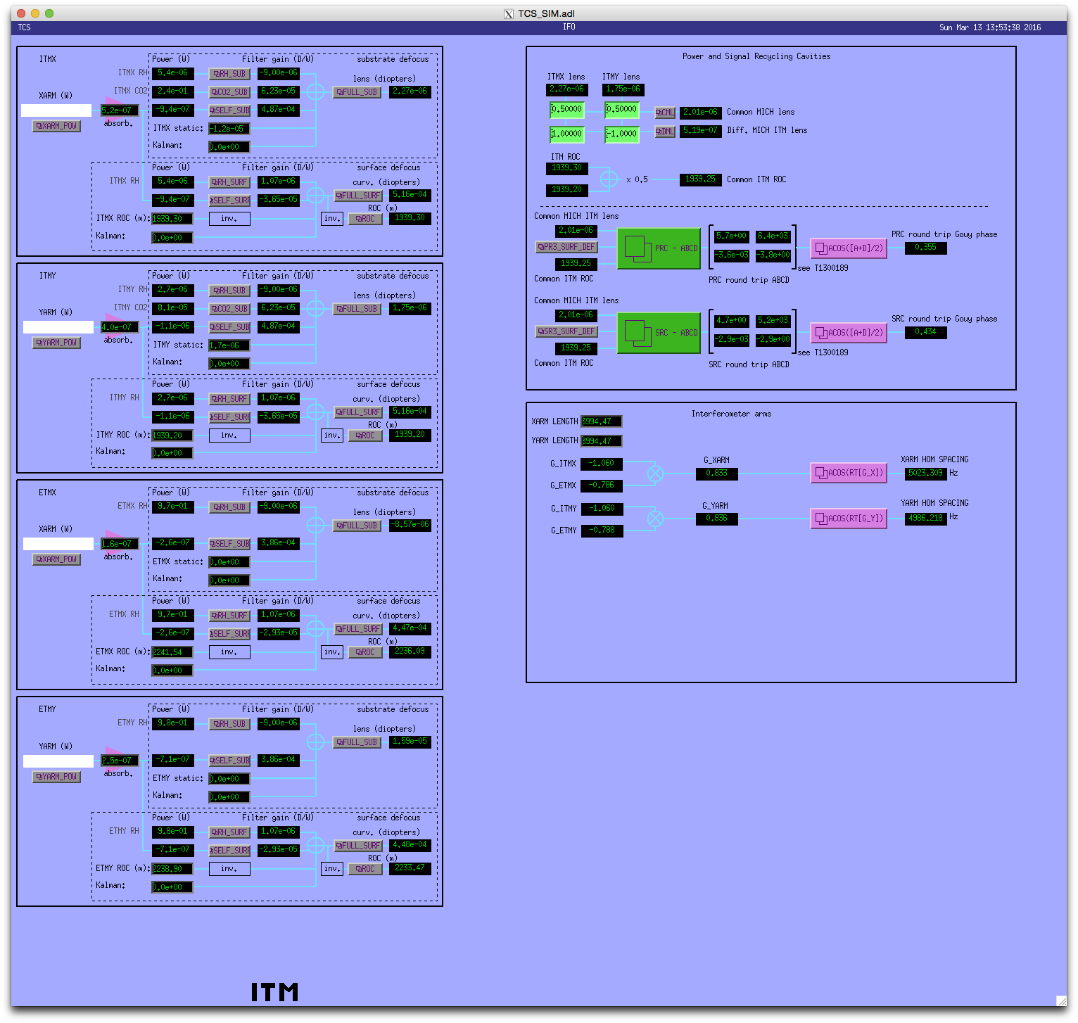
MEDM screen
H1:TCS-SIM_ITMX
H1:TCS-SIM_IFO

Slide 7
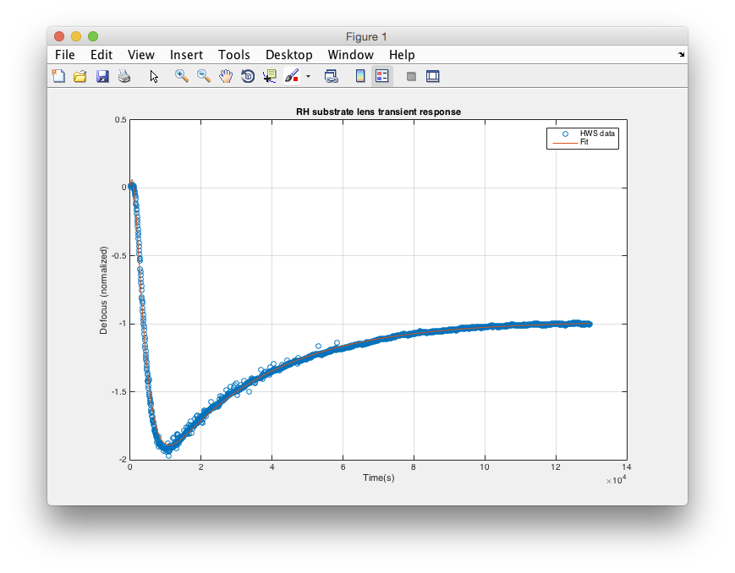
Model of Test Mass
H1:TCS-SIM_XARM_POWER
Notes:
Simulate step response of thermal lens as a sum of exponentials (low-pass filter)
Each exponential is a pole:
LPF with frequency of 1/tau/(2*pi)
The sum of them gives N poles and N-1 zeros
Create your filter.
Good approximation for transient response
Based on models and IFO measurements
Absorption measurements

Slide 8
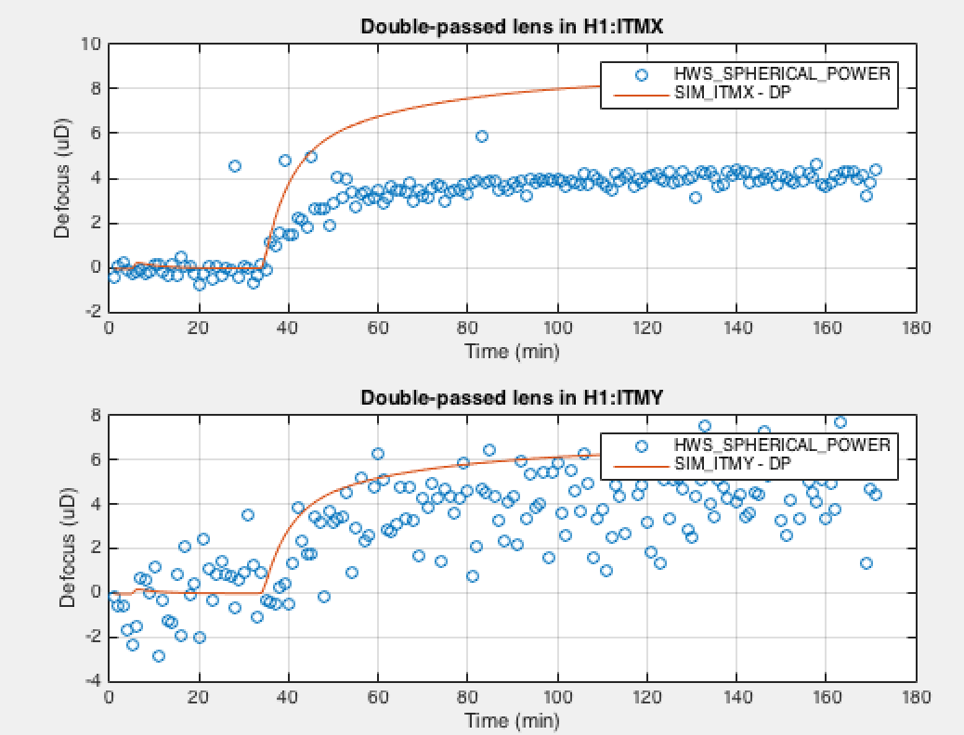
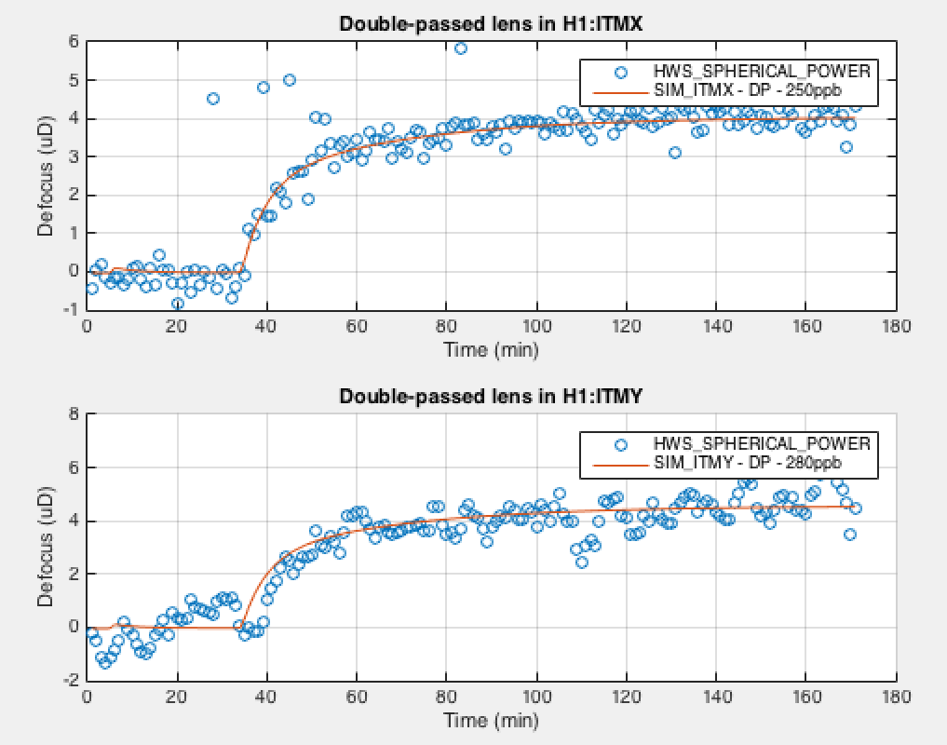
Example: Self Heating LHO ITMX and ITMY (11-Mar-16)

Slide 9
Outputs: Recycling Cavities
Common and differential MICH lenses
Round-trip ABCD matrix
Gouy phase
TEM00 mode

Slide 10
Outputs: Arm Cavities
Round-trip ABCD matrix
TEM00 size/ROC at ITM
G-factor of arm-cavities
HOM spacing frequency change
Mode-overlap of arm cavity modes
with SRC/PRC (in progress)
Torsional spring constant (provisional)

Slide 11
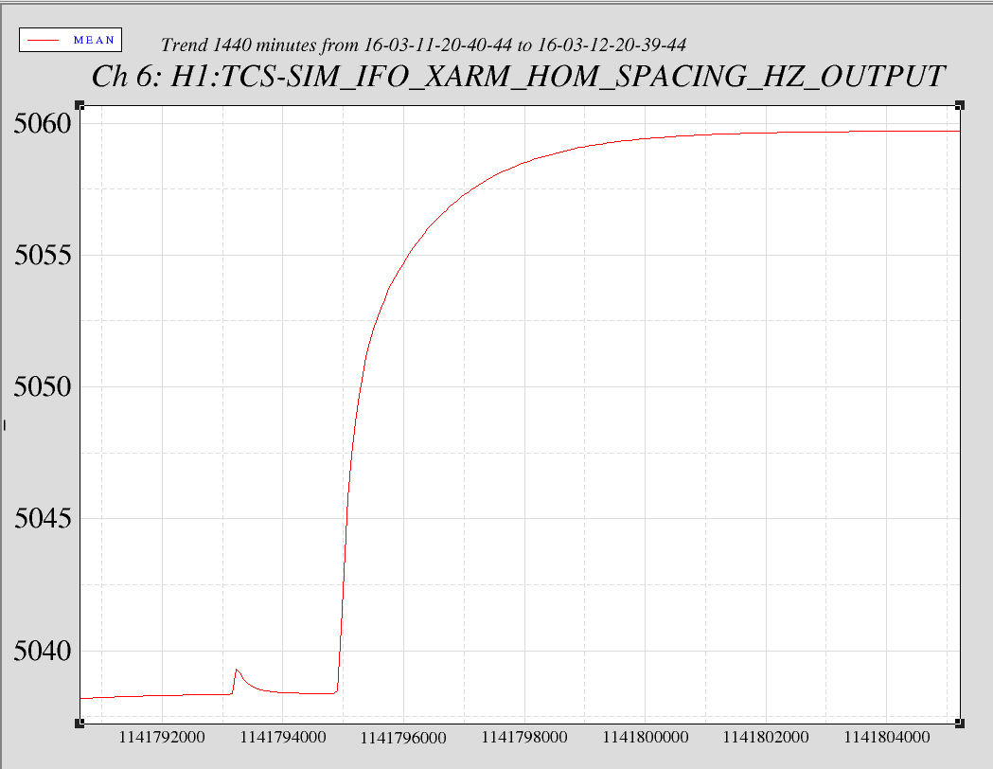
Example: HOM spacing (ΔP = 2.5W)

Slide 12
Conclusion
What’s the best way to estimate the current modal state of the IFO using all our information?
Guide mode-matching for SQZ
Higher-order modes < TEM20?
More important for O3
Get better calibrations into model

Slide 13
Absorption measurements
https://dcc.ligo.org/LIGO-T1400685
 | LHO | LLO
ITMX | 200 ppb | 400 +/- 100 ppb
ITMY | 140 +/- 40 ppb | 300 +/- 100 ppb
ETMX | 520 ppb | 160 +/- 25 ppb
ETMY | 2080 ppb ?? | 230 ppb

Slide 14
Kalman Filtering (future)
State space model
Determines optimum estimate of current state
Based upon:
Known inputs to the system
Dynamics of the system
Measured outputs
Kalman filter to improve our estimate of thermal state
HWS signals
HOM spacing?
RH
State-Space Model
(a priori)
HWS
CO2
HOM
self
State-Space Model
(aposteriori)

Slide 15
Steady-state gains (D/W) & combine
RH + SELF + CO2 – responses of different components listed
All filters are set to gain of 1 at DC
Added together for total lens/ROC
Static lens included
Kalman term included (can be added later Kalman filter code to improve the estimate).

Slide 16
Overview
Why an online simulation?
Purpose
Mode-matching, Thermal state
Monitoring of absorption
Approximation of state-space model
What are the inputs?
What am I simulating
Thermal lenses and ROC of test masses
Derive estimates of IFO parameters dependent on g-factor
Gouy phase, G-factor, HOM spacing
What are the outputs?
Kalman filtering
How does it work?

